Slide 1
MEDICINAL CHEMISTRY
JUSTICE BASHEER AHMED SAYEED COLLEGE FOR WOMEN
(Autonomous)
Department of Chemistry

Slide 2

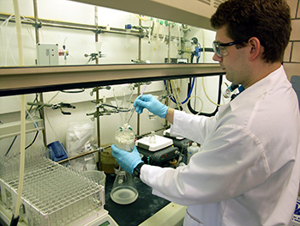
Medicinal chemistry
A branch of chemistry which mainly deals with the design, development and synthesis of pharmaceutical drugs

Slide 3

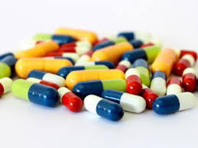
Objective
Classification of drugs
Nomenclature of drugs
Common diseases and their treatment by drugs

Slide 4
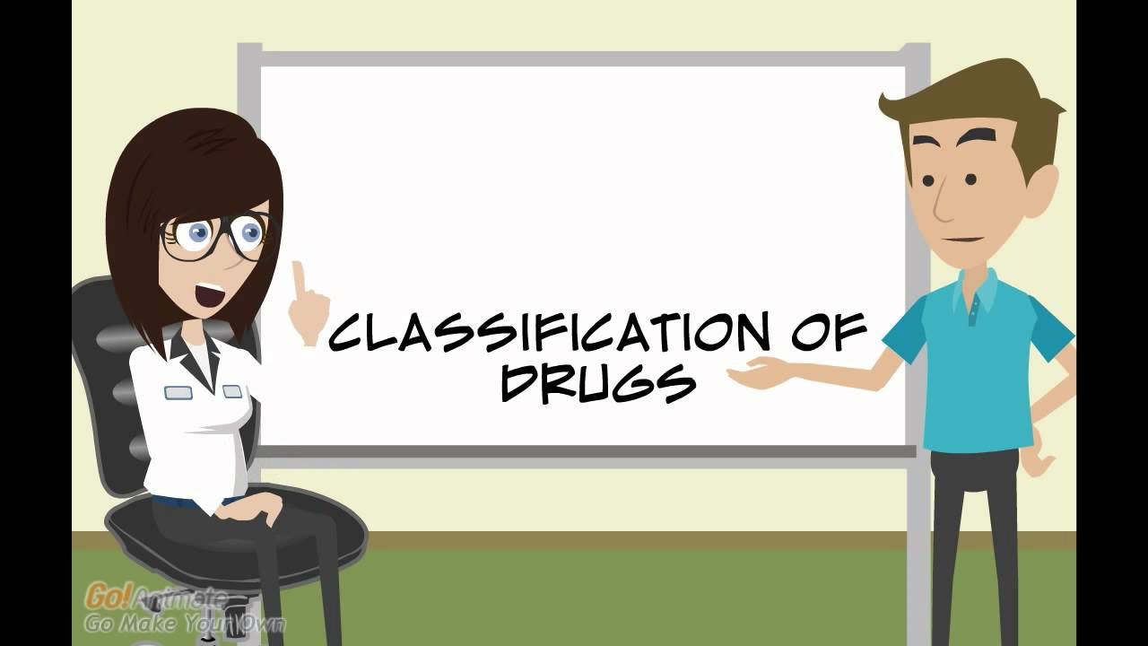
Biological classification
Chemical classification
Commercial classification

Slide 5


Nomenclature of drugs
Analgesics
Antipyretics
Anesthetics
Anti-inflammatory drugs

Slide 6


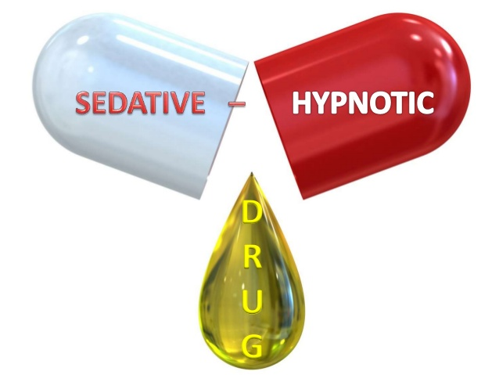
Drugs affecting central
nervous system
Tranquilizers
Sedatives
Hypnotics

Slide 7

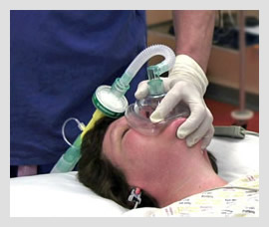
Anesthetics
Local Anesthetics- induces the absence of sensation in a specific part of the body
General Anesthetics – induces a state of unconsciousness with the absence of pain sensation over the entire body

Slide 8



Common diseases
Diabetes
AIDS

Slide 9



Slide 10
CONCLUSION
One should have enough knowledge about the drugs, its dosage, drug action and its side effects in order to treat a particular disease.
One can also create awareness regarding drugs among the public.

Slide 11

THANK YOU

